Slide 1

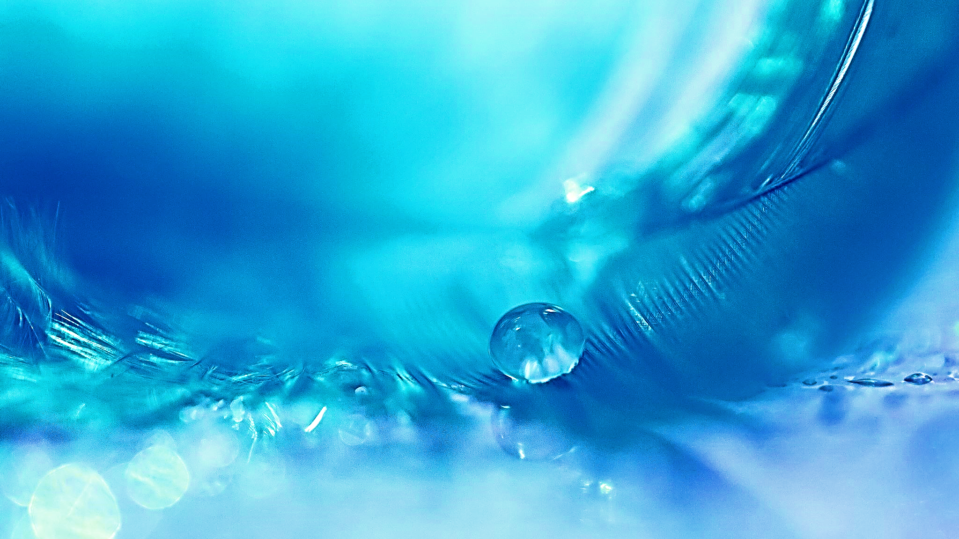
The Water Crisis and Data Science
By: Julia Ferris

Slide 2
Water Use
Humans use water at a faster rate than ever before
This water must be clean for safe use
Hundreds of millions of people around the world do not have access to safe, clean water
Drinking
Cleaning
Agriculture
Being aware of unnecessary or excessive water use can help reduce the problems the world is facing

Slide 3
Water Quality
Water is everywhere, but most of the water is unsafe for use
Water purification is a necessary process to treat most water
Problems:
Water pollution and contamination
Polychlorinated biphenyls dumped in the Hudson River by GE
Metals in water
Flint water crisis
Bacteria / Diseases
E. coli found in drinking water
Early detection of problems is essential for human and environmental health
Notes:
PCBs in Hudson

Slide 4
Data Science
Smarter water use
Monitoring of resources
Water quality forecasting
Identifying issues in the water supply
Tracking sources of contaminated water
Predicting water shortages
Article – detecting and diagnosing causes of water contamination
“A data-driven method for detecting and diagnosing causes of water quality
contamination in a dataset with a high rate of missing values”

Slide 5
My research
Data
Source: AQUASTAT, Food and Agricultural Organization of the United Nations
Variables:
Agricultural water withdrawal (%)
Industrial water use efficiency (USD/m³)
Irrigated Agricultural water use efficiency (USD/m³)
Services water use efficiency (USD/m³)
Water use efficiency (USD/m³)
Water stress (%)
Trends over time in Canada (population > 38 million), the U.S. (population > 331 million), and Mexico (population > 126 million)
Notes:
Water sources

Slide 6
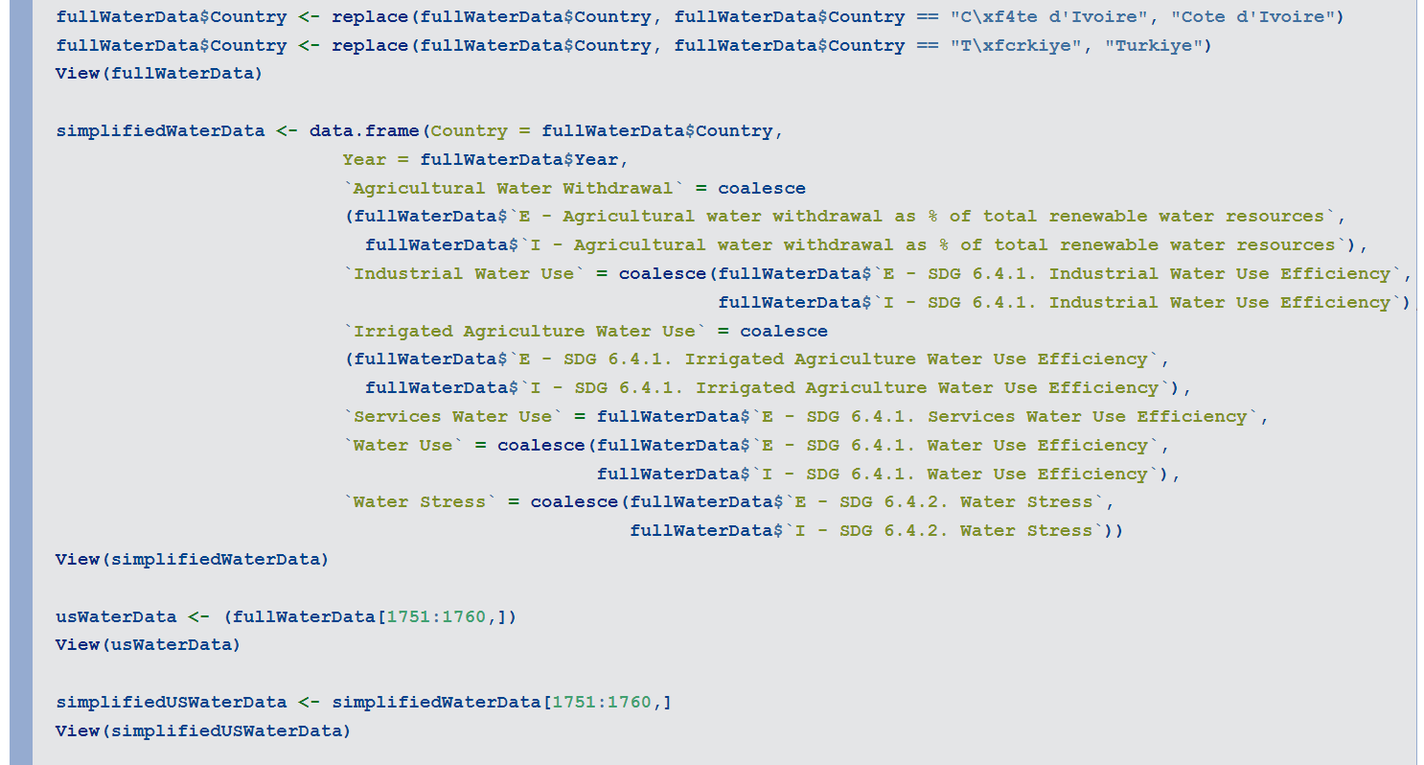
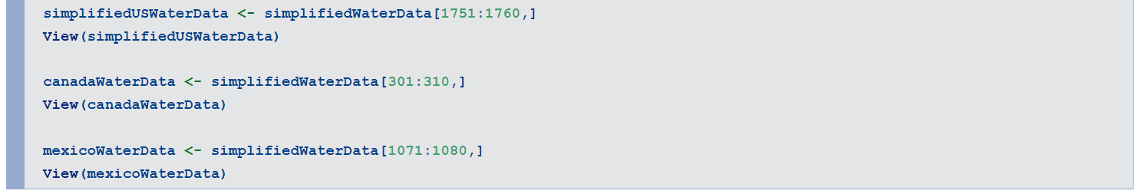
Code
Notes:
Add a link (slide 3)

Slide 7
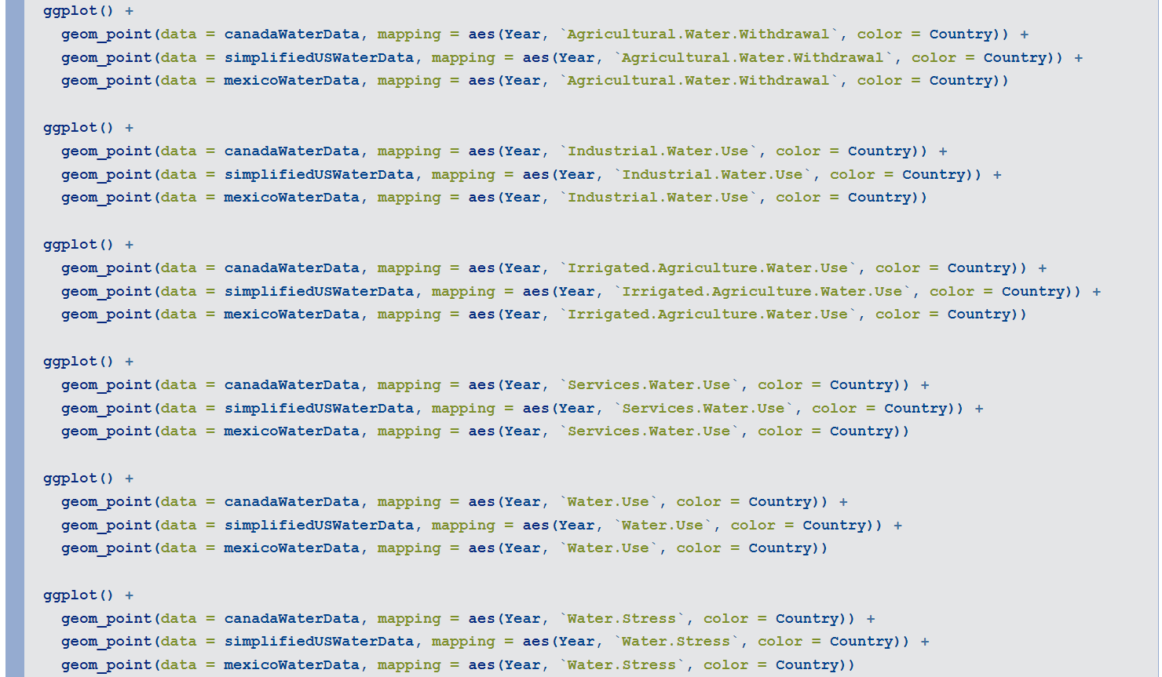
Code

Slide 8
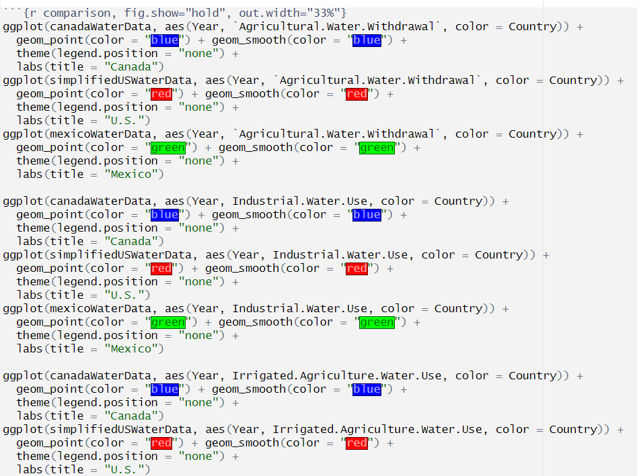
Code

Slide 9
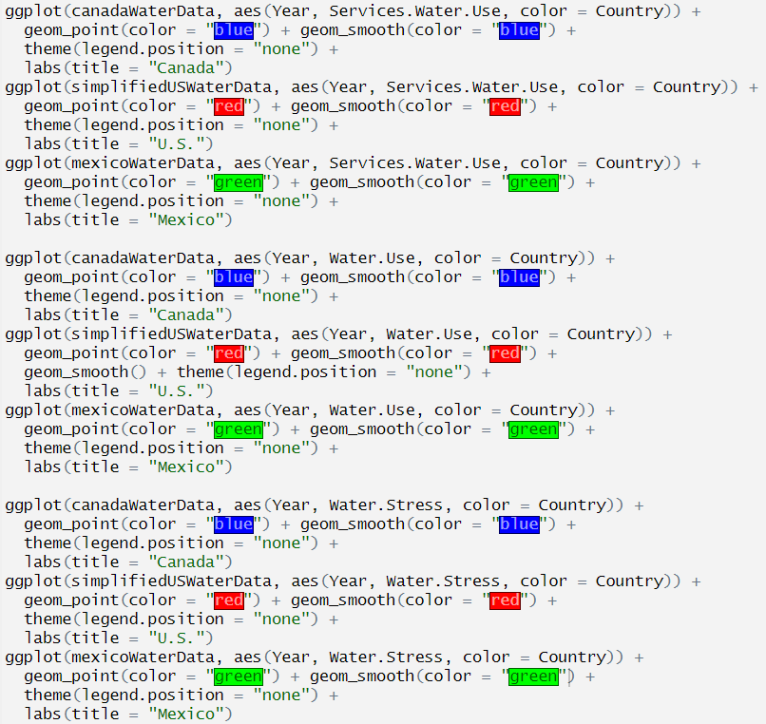
Code
https://github.com/juliaDataScience-22/cuny-fall-23/blob/manage-acquire-data/Water-DataScienceContext.Rmd

Slide 10
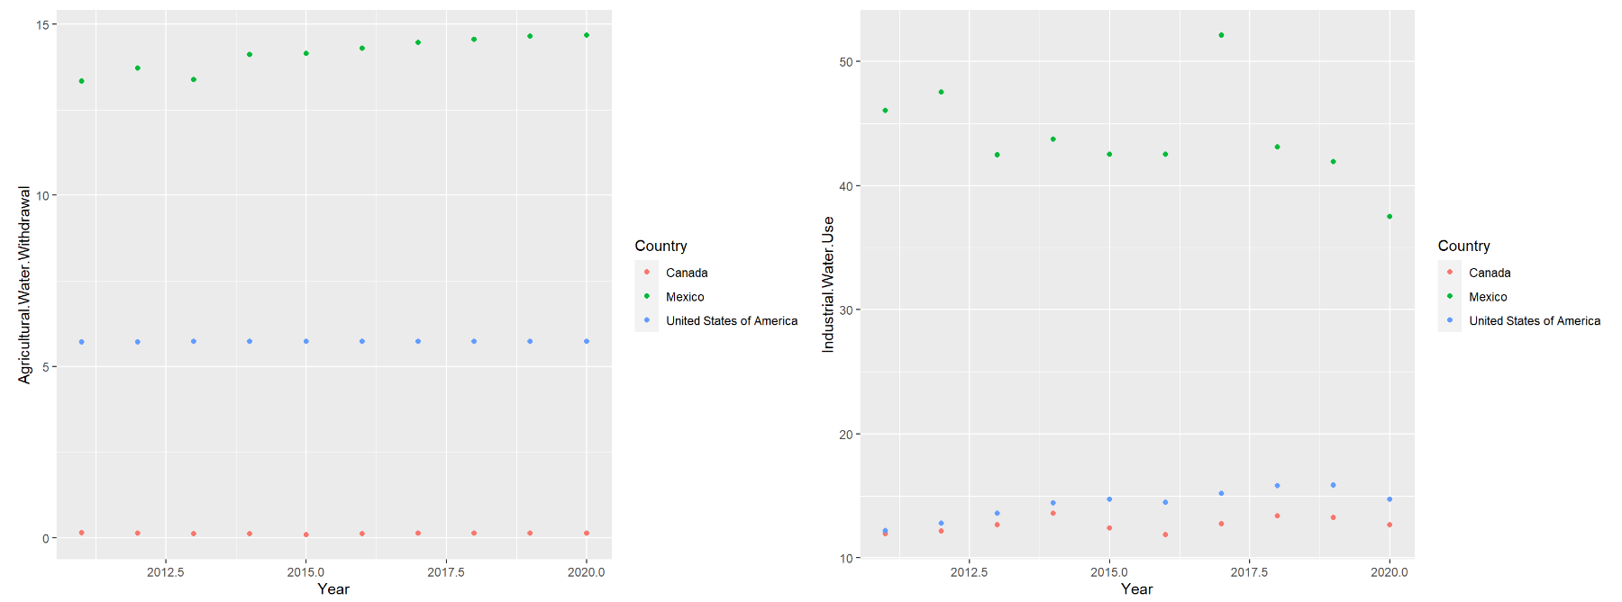
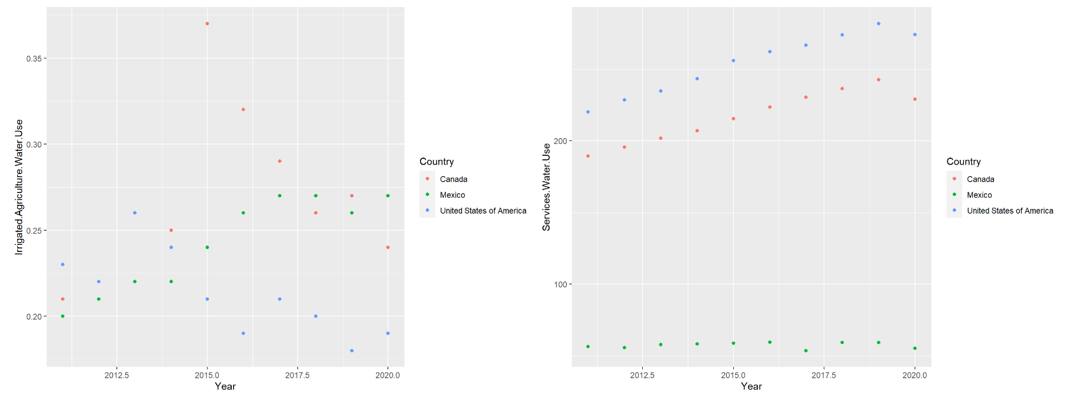
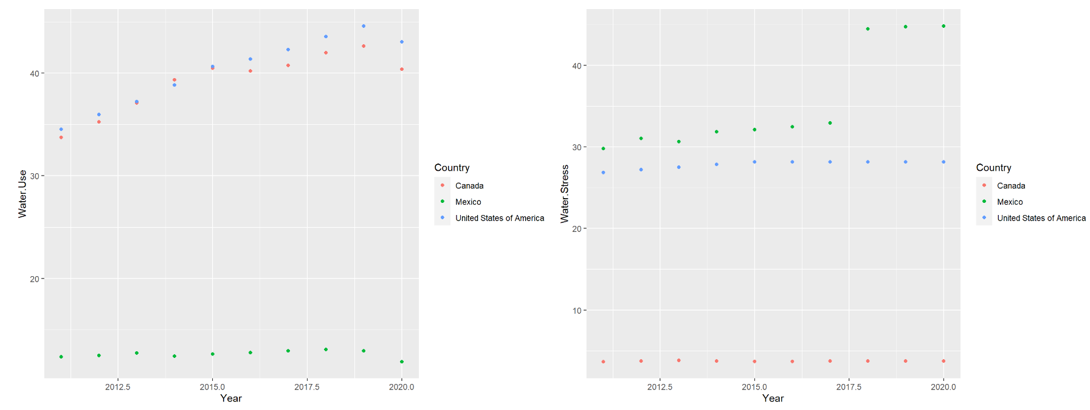
OVERVIEW

Slide 11
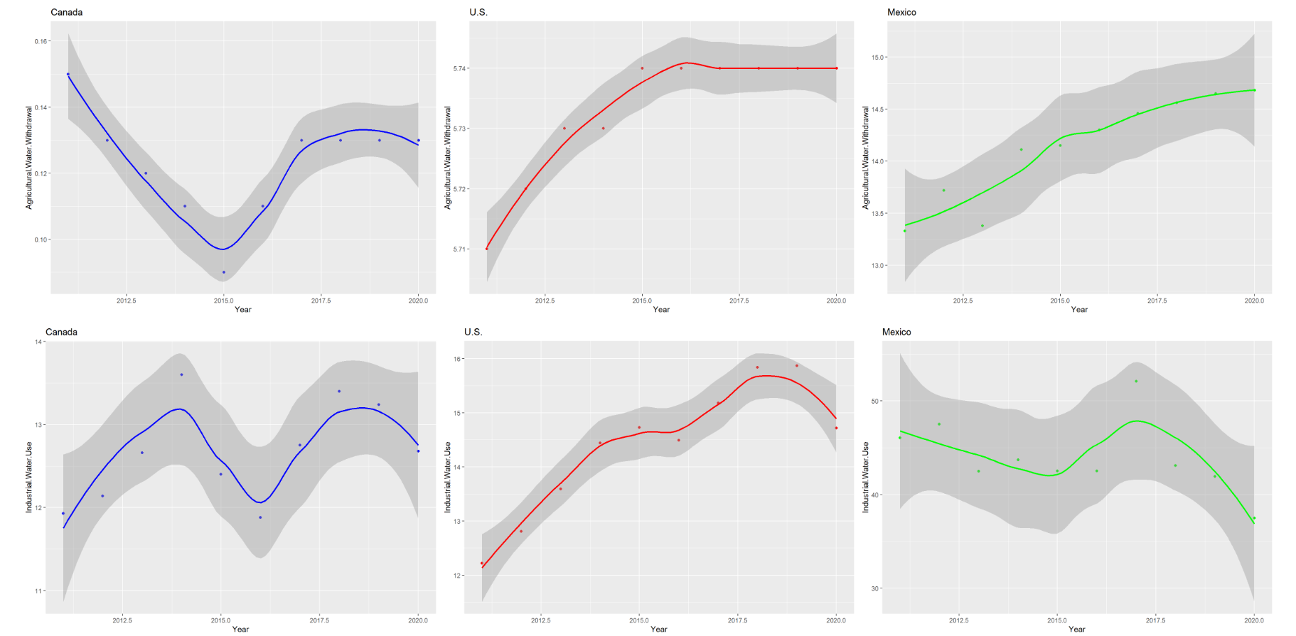
GraphS

Slide 12
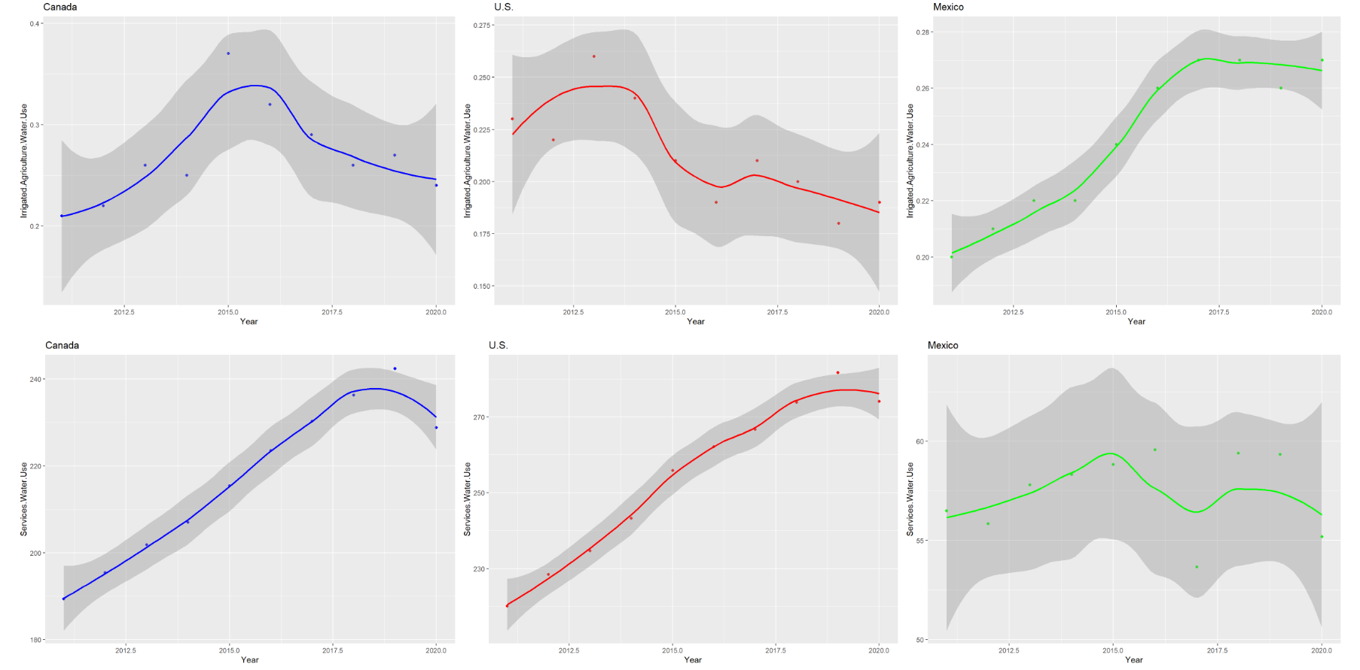
Graphs

Slide 13
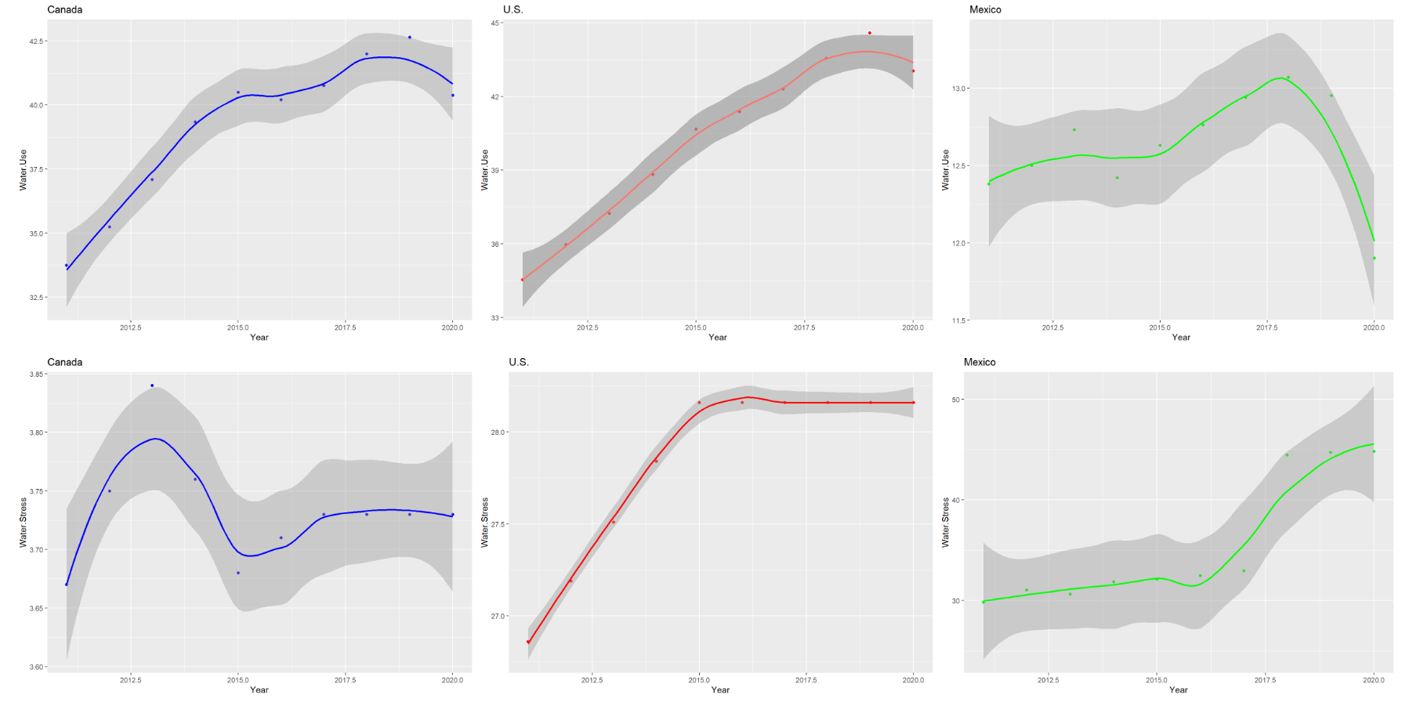
GRAPHS

Slide 14
Conclusions
The Water Crisis relates to data science because data science can be used for
Smarter water use
Monitoring resources
Forecasting water quality
Identifying issues in the water supply
Tracking contaminated water sources
Predicting water shortages
Canada, the U.S., and Mexico use water to different capacities in terms of water use efficiency and water stress
When comparing different countries, we need to take into account factors like climate, population, and water sources

Slide 15
SOURCES
AQUASTAT Dissemination System. Food and Agriculture Organization of the United Nations. (2020). https://data.apps.fao.org/aquastat/?lang=en
AQUASTAT - FAO’s Global Information System on Water and Agriculture. Food and Agricultural Organization of the United Nations. (n.d.). https://www.fao.org/aquastat/en/
Hudson River PCBs. Riverkeeper. (n.d.). https://www.riverkeeper.org/campaigns/stop-polluters/pcbs/
Wiley University Services. (2023, January 12). How Is Data Science Being Used to Tackle the Global Problem of Clean Water?. Discover Data Science. https://www.discoverdatascience.org/social-good/clean-water/
The Water Crisis. Water.org. (n.d.). https://water.org/our-impact/water-crisis/
New York City water - the largest unfiltered water system in the US. The Berkey. (n.d.). https://theberkey.com/blogs/water-filter/new-york-city-water-the-largest-unfiltered-water-system-in-the-us
Snapshots Portal. United Nations. (n.d.). https://www.sdg6data.org/en/snapshots?country=#demo-wrapper
Water stress. Water Scarcity Atlas. (n.d.). https://waterscarcityatlas.org/water-stress/
Ngouna, R. H., Ratolojanahary, R., Medjaher, K., Dauriac, F., Sebilo, M., & Junca-Bourié, J. (2020). A data-driven method for detecting and diagnosing causes of water quality contamination in a dataset with a high rate of missing values. Engineering Applications of Artificial Intelligence, 95, 103822. https://doi.org/10.1016/j.engappai.2020.103822

Slide 16



Questions .

